Slide 1








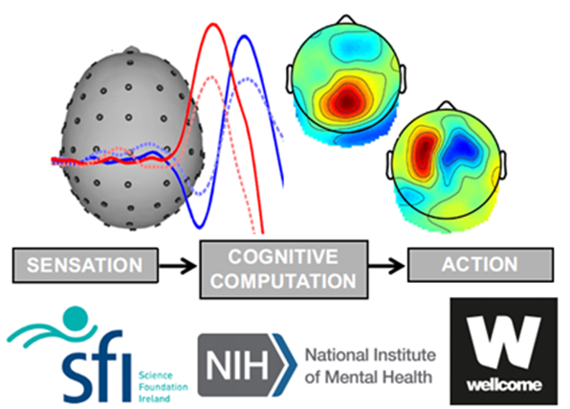


The influence of response effector on decision adaptations
23/04/2024
Lab meeting- Apr 2024
School of Electrical and Electronic Engineering
University College Dublin,
Biomedical Engineering, Dublin, Ireland,
liang.tong2@ucdconnect.ie
Liang Tong
17208987
Notes:
下午好，正在学习的项目是

Slide 2
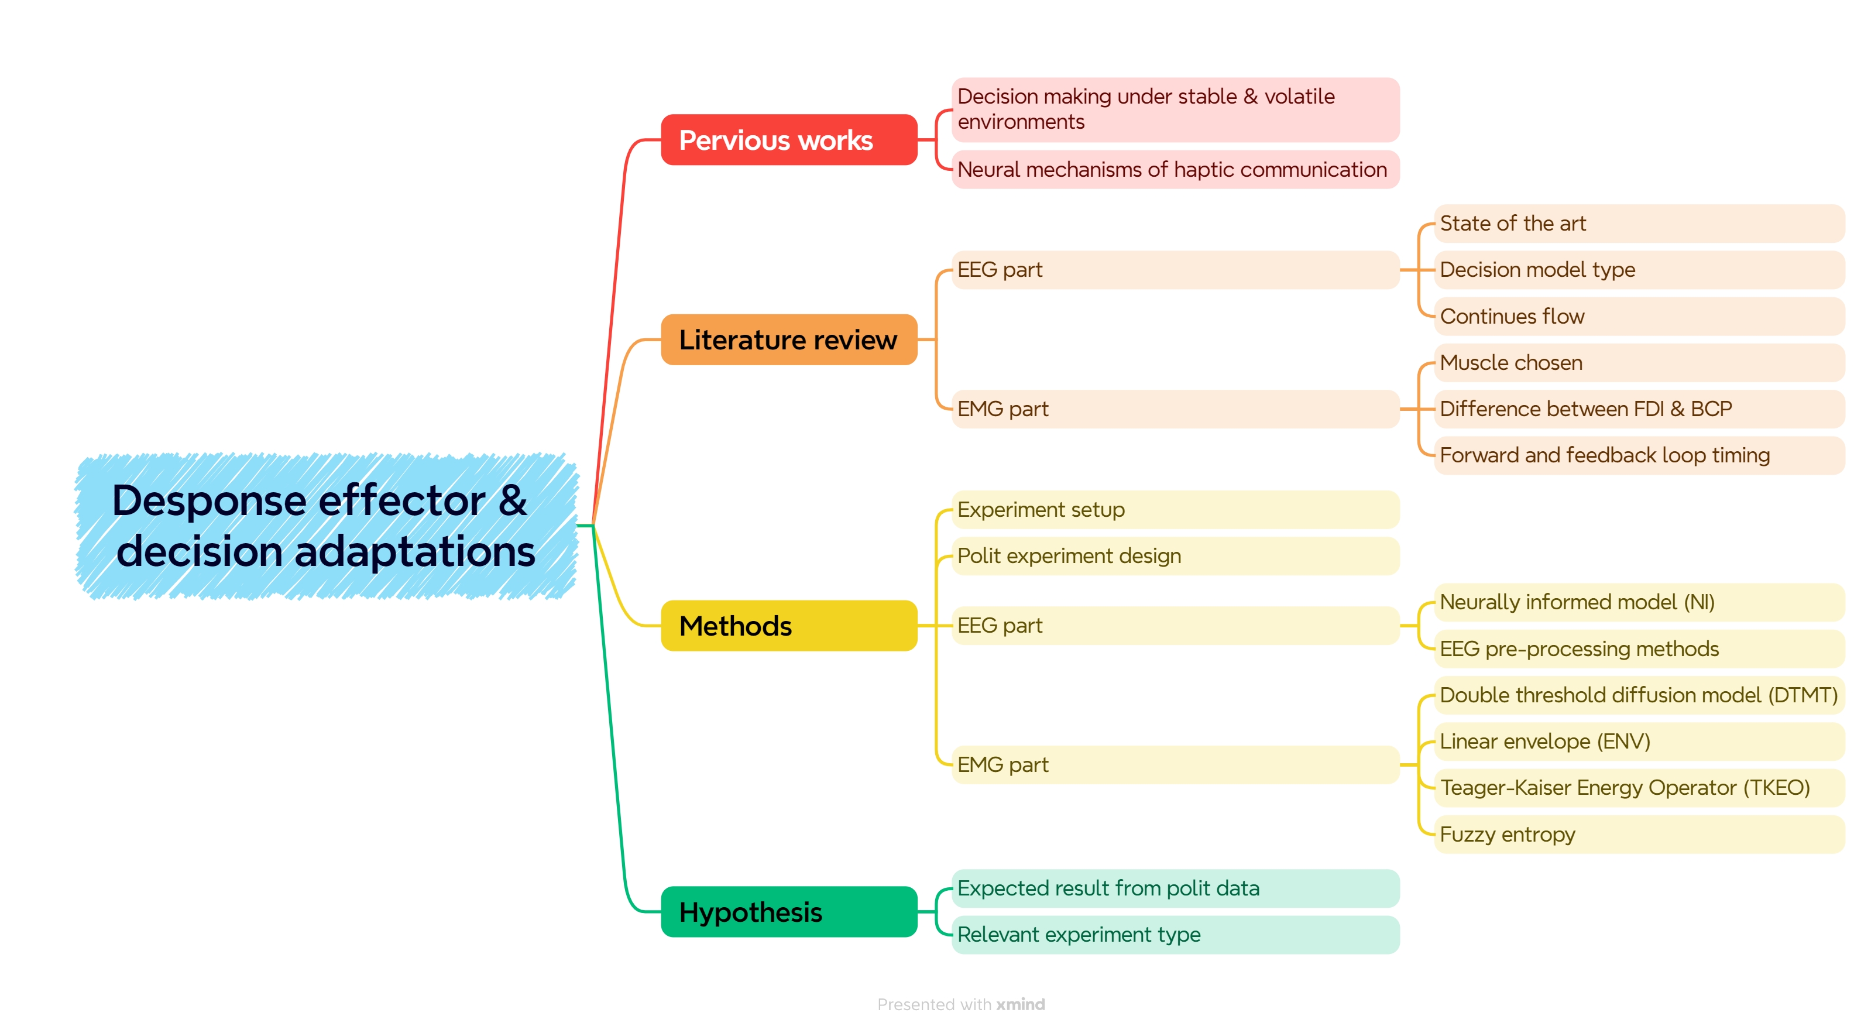
Notes:
我对人类生理电信号有热情，对计算模型也很感兴趣，所以我很幸运现在能能同时研究EMG和EEG两大部分,并学习最authoritative的模型
我最后一年项目和Simon和Elisabeth 学leaky accumulation in stable and volatile environment。然后去London用EEG hyper-scanning 做haptic communication/social interaction的研究。（我会用一张slide总结前两个projects）
现在跟着Elaine和Simon从一月开始做这个new promising project。关于不同 response effector 对决策适应的影响，因为大脑的一大特征是对不断变化的环境是实时适应的，
所以我主要讨论我现在学习的课题，主要关于文献的总结，任何建议都会十分有帮助，请在任何时候打断，纠正不对的东西在slide上，值得更深入的研究的点
方法和文献分为EEG part和EMG part
这是主要的结构

Slide 3
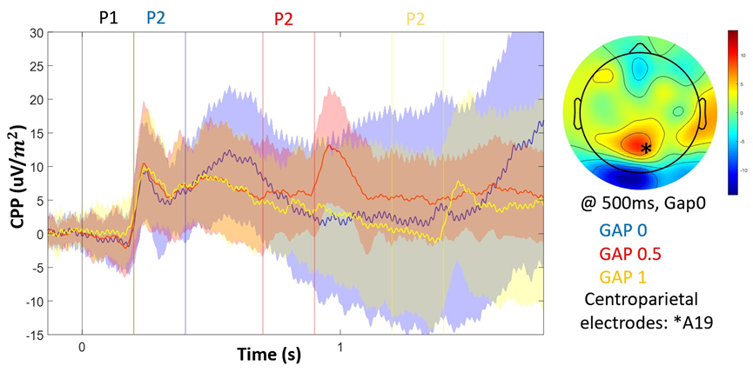
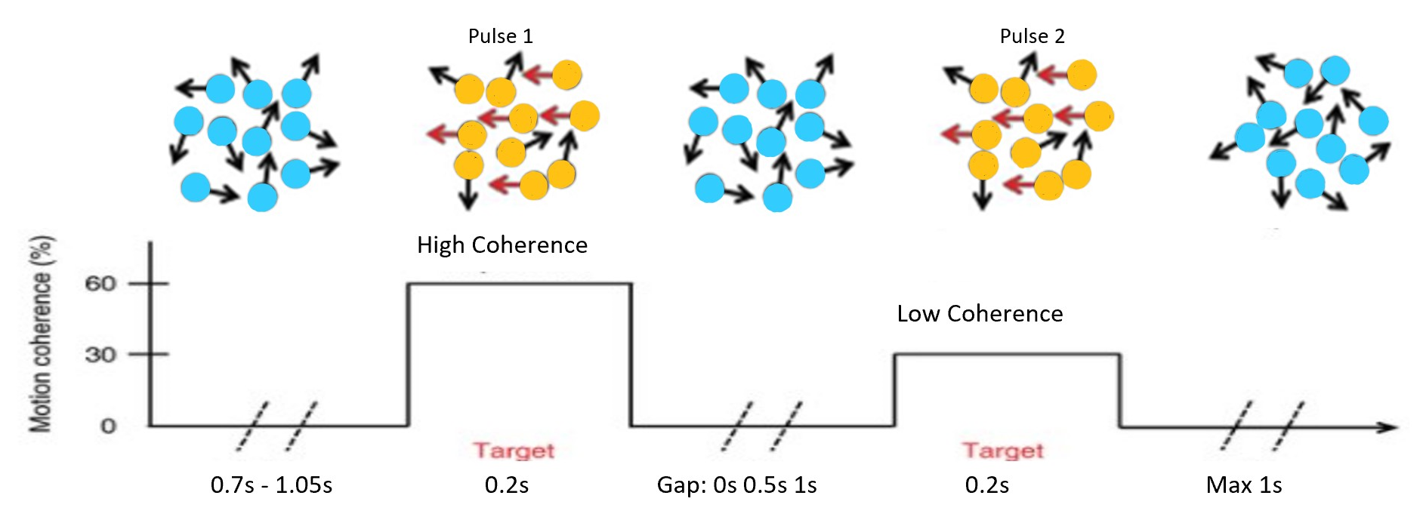
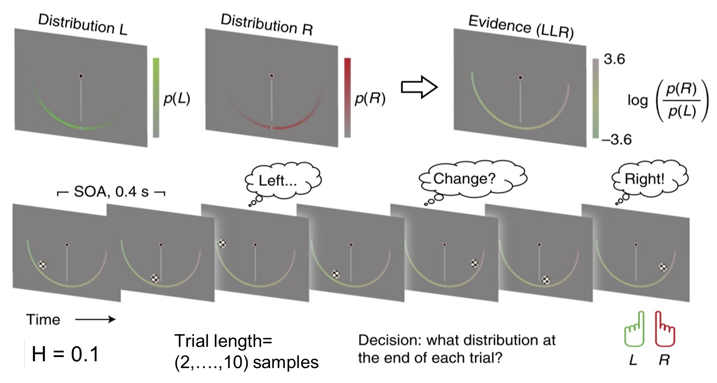
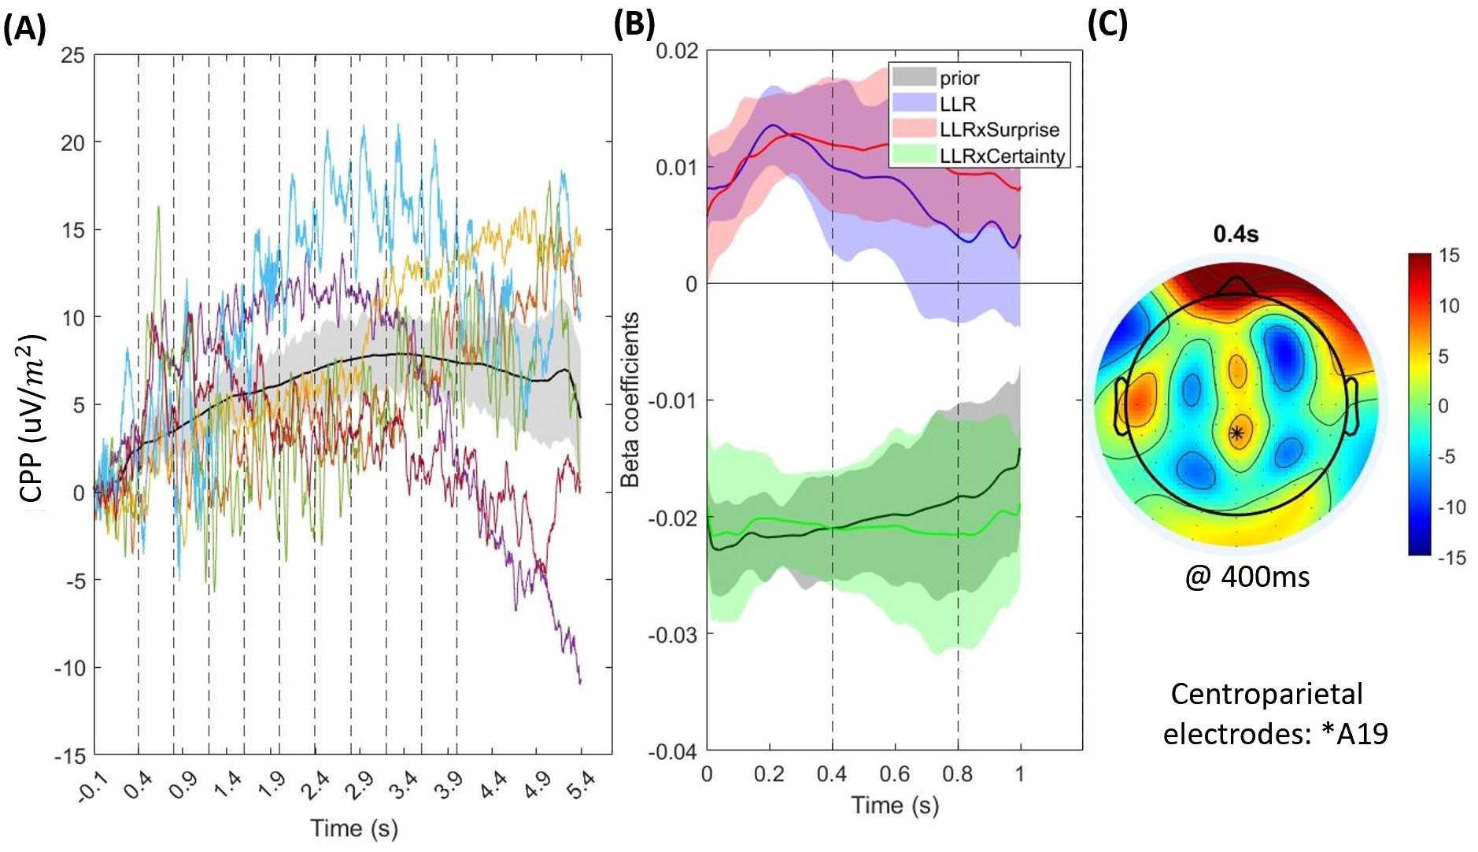
Notes:
一张图介绍我之前的每个项目
主要学习了了两个实验，对于稳定和不稳定环境，并学了CPP对于不同环境的不同。比如perfect (lossless) accumulation 在稳定环境和leaky accumulation在volatile environment

Slide 4
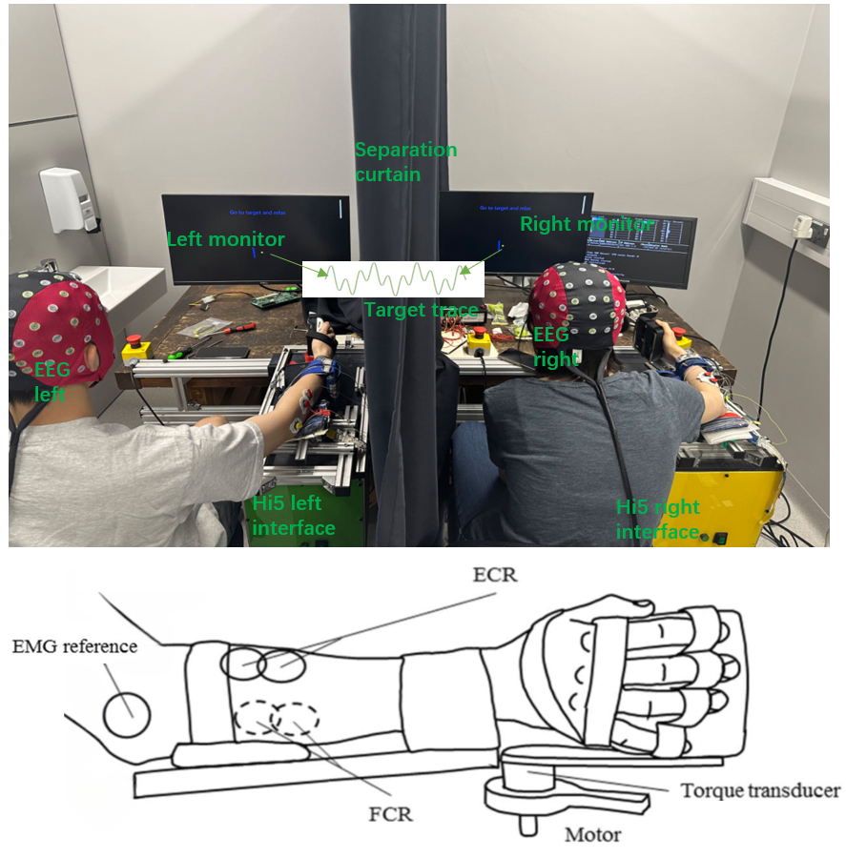
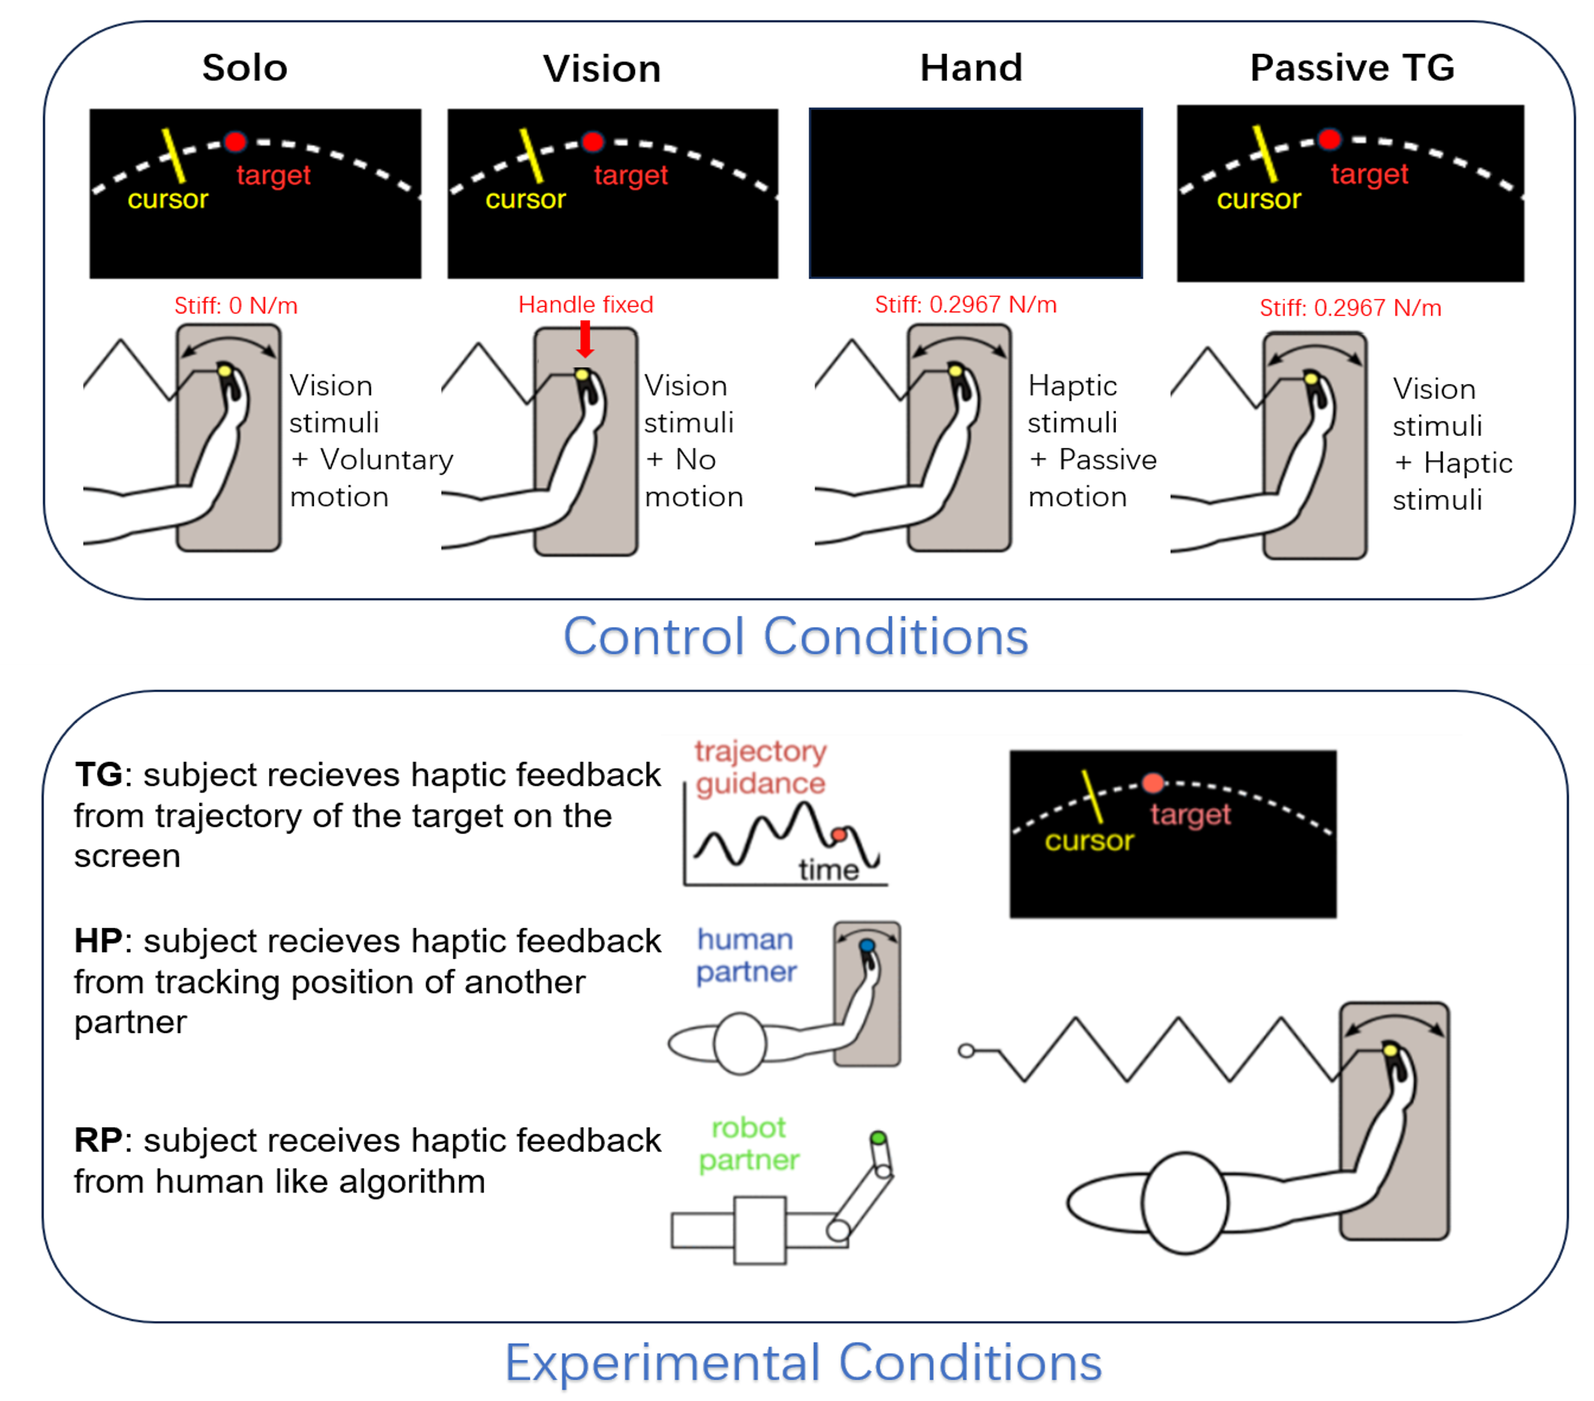
A
B
Notes:
去年做的用EEG hyper-scanning 做haptic communication/social interaction的研究，同时对EMG，力矩，error rate进行分析
主要用了Fuzzy entropy和 IBS对 不同实验条件和不同脑区的分类。证明了类人算法的机器人也可与真人产生社交互动。
现阶段下一个学生在继续做leader/follower的研究
如有时间可以讨论一些通用的方法，我有一些backup slide 对于之前研究的方法
%%%%%%%%%%%%%%%%%%%%%%%
比如IBS 变成inter-trial

Slide 5
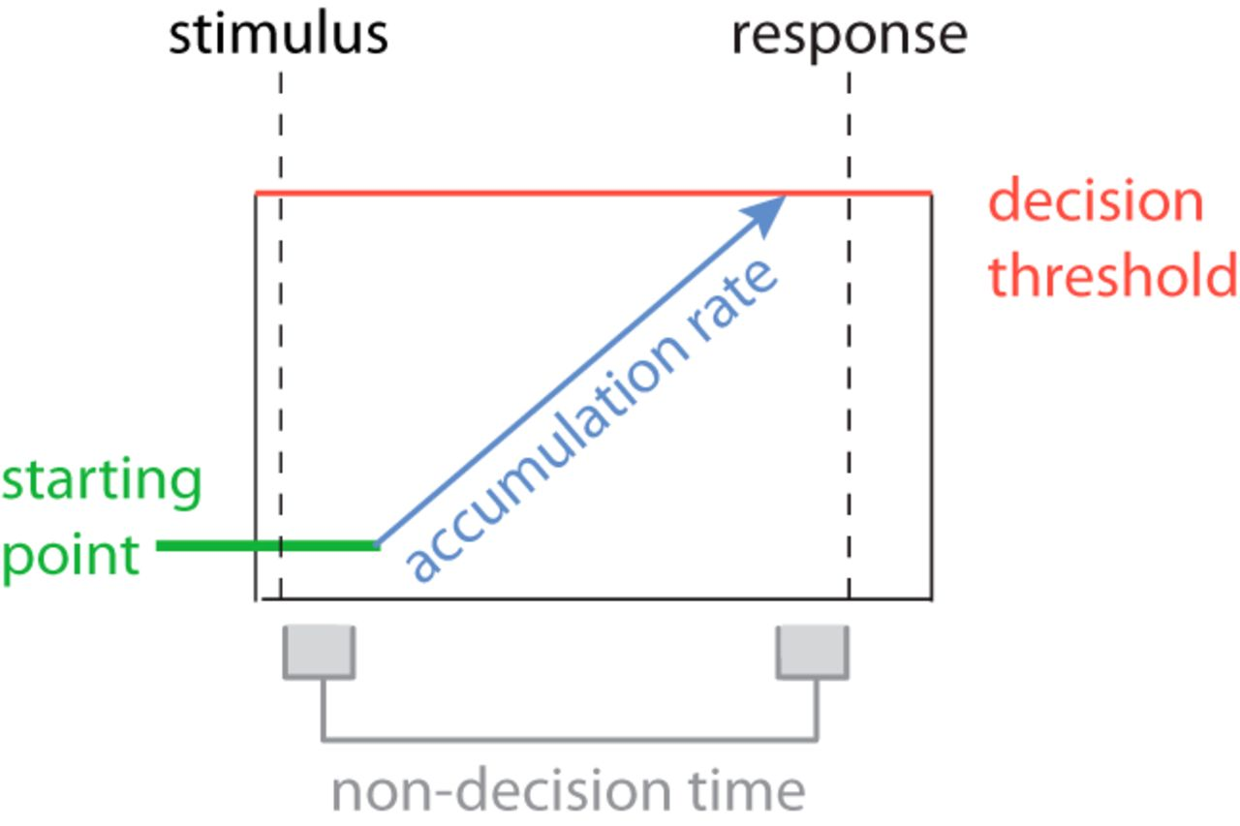
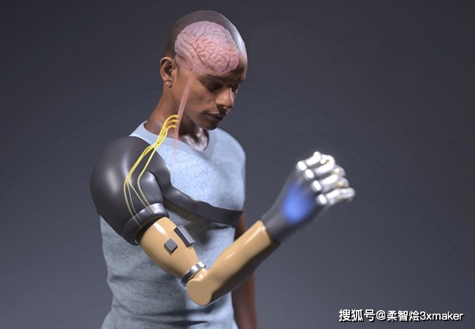
State of the art
SSM can’t distinguish three decision process
Motor process is simplified as delay
Top-down continues flow
Down-top feedback flow
Should explain motor control better
Questions
Whether Decision adaptation between sensory to motor area is muscle dependence?
The precise timing of decision commitment
Notes:
1.SSM 不能区分三大进程sensory，cognitive， motor
2.大多数决策用简单动作（按钮或鼠标），造成两个问题。第一把motor process 简化为delay，第二集中在远端肌肉，但假肢用近端比较多，且手与脑区的链接比手臂多且复杂
3.存在自上而下的连续流，从sensory 不停流向neuromuscular
4.运动系统的实时状态也可影响sensory area
6.需要解释neuro-musclar中的motor control， 在老的SSM里归类为前两个进程如perceptual/cognitive
Q
whether Decision processing from sensory to motor area same?
Whether the adaptations of motor preparation signals is muscle dependence when apply (seed pressure, prior….)/?
This project aims to use a myoelectric interface to compare decision-making processes between finger and bicep movements under different conditions. The goal is to understand if our ability to adapt decisions in real-time depends on the muscle being used. By analyzing brain signals and behavior, we can learn if there are differences in how evidence is processed and if this affects motor control.
因为大多数DM操作的是sensory和cognitive 层面，有了EMG界面的帮助可以操作motor 层面, 且可以确定决策commitment

Slide 6
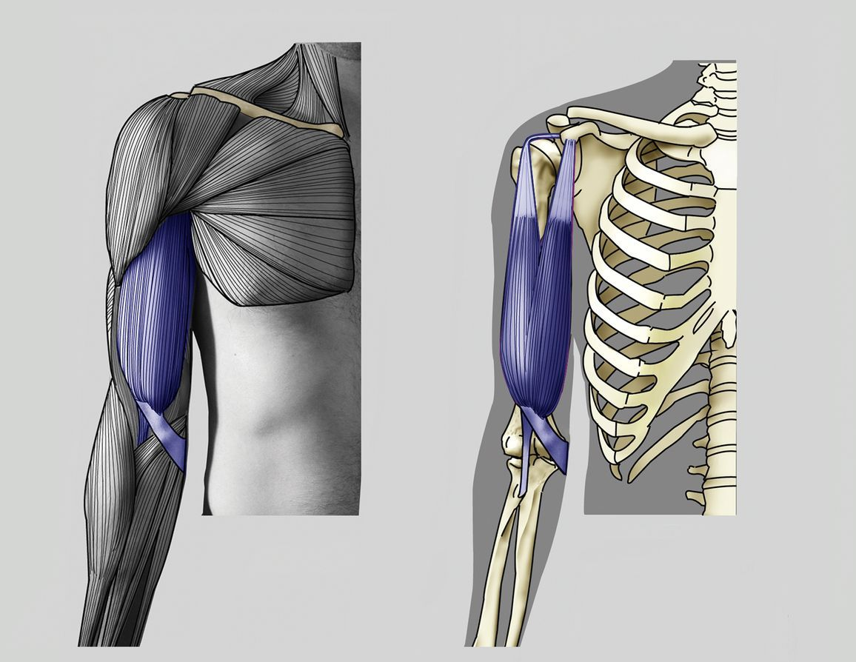
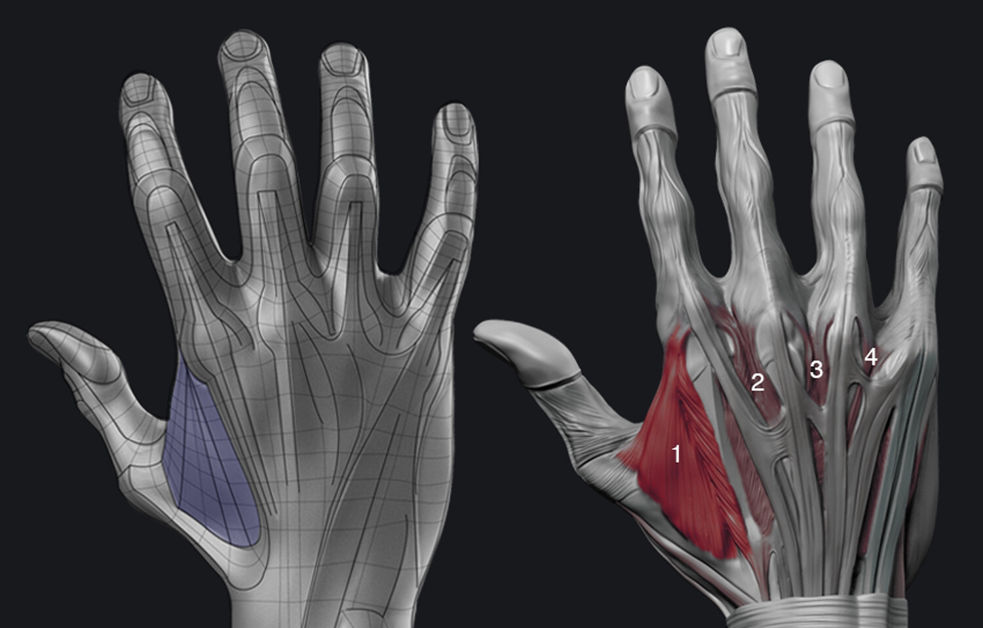
Response effector & Decision making
Proximal muscle vs Distal muscle
Bicep (BCP) vs First dorsal interosseous (FDI)
Neck- biceps- FDI (motor delay increase)
Eye (sensory encoding delay)
Palpation
Notes:
先讨论EMG part
我们选择这两个作为进远端
但其他肌肉的研究也可做为参考。 比如头颈和眼睛
首先发现 RT 时间增加由于motor excution而delay
Top-down and feedback. Eye is longer because sensory encoding delay
大部分研究对肌肉的定位都是触摸诊断
所以选了两个研究最常用的肌肉

Slide 7
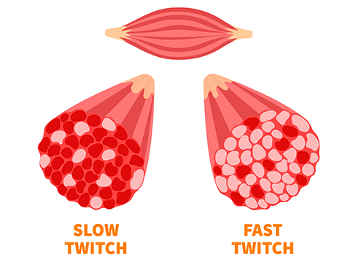
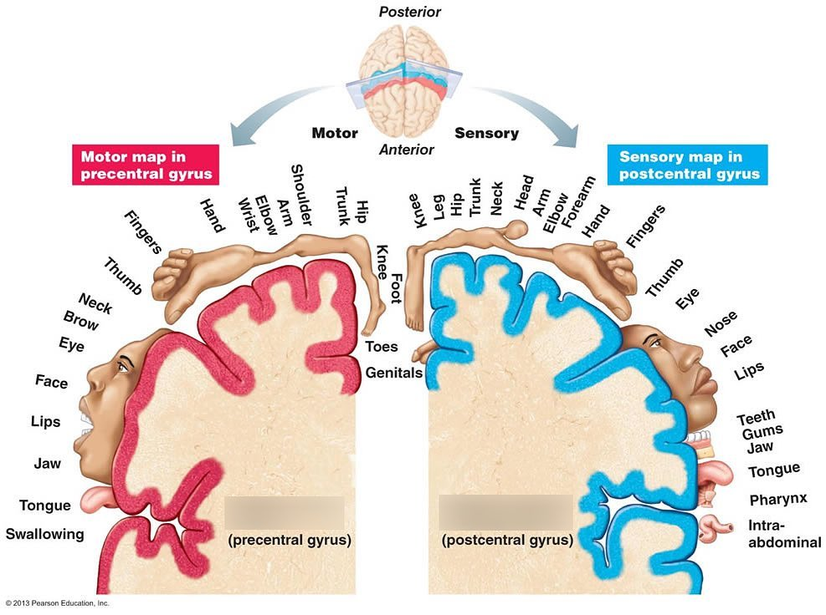
Physiological and neural difference
Biceps
Type I (slow-twitch)
Predetermined motor programs
Sustained, Stable movements
more medial areas of the motor cortex
FDI
Type II (fast-twitch)
Sensory feedback
Precise movements
more complex sensorimotor integration
Notes:
比较两个肌肉
二头肌motor unit更大，更多type1 fiber导致对fatigue的耐受和对Sustained, Stable 移动的支持（少改变）。且更依赖预编程的指令（像series模型少feedback）模型会后面说。
根据boardman map，位置更接近与中间
而远端肌肉motor unit由更小的Type2组成，让它启动更快改变和准确，但更容易疲劳。为了更准确motor planning and execution所以存在sensory feedback ，所以实时调整更像平行模型
且脑部与FDI的连接更多，同时更多的脑区会参与控制（比如cerebellum and basal ganglia ）
%%%%%%%%%%%%%%%%%%%%%%%%%%%%%%%%%%%%%%%%%%%%%%%%%%%%%%%%%%%%%%
Proximal muscles tend to have larger motor units and a higher proportion of Type I (slow-twitch) muscle fibers, which are more resistant to fatigue and are suited for sustained, stabilizing contractions. (? may rely more on predetermined motor programs (more series model) due to their role in providing stability and generating gross movements, less relying on sensory feedback?)
Proximal muscle: often initiated by more medial areas of the motor cortex (?adjust channel selection?)
Distal muscles often have smaller motor units and a higher proportion of Type II (fast-twitch) muscle fibers, which are capable of rapid, fine, and precise movements but are more susceptible to fatigue.
require a high degree of sensory feedback for accurate motor planning and execution. feedback loop(?link to model: feedback loop?) is critical for adjusting movements in real-time (?more parallel or embodied model?).
Distal muscle: high degree of coordination and precision, more complex neural mechanisms, including greater involvement of the cerebellum and basal ganglia (engage more lateral and anterior parts of the motor cortex and involve more complex sensorimotor integration)

Slide 8
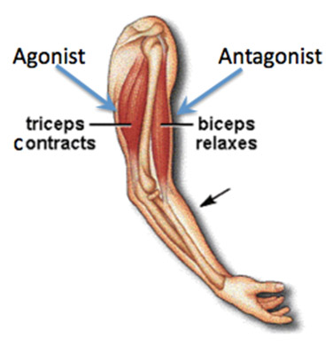
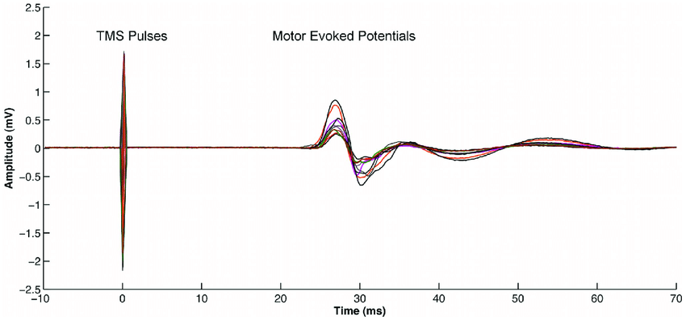
Study between Biceps and FDI
Motor preparation in the intended agonist but not antagonist muscle.
MEP was present in more proximal muscle
Notes:
有实验比较 让参与者 休息，观察写字，观察手臂移动
记录TMS 来学习观察时他人运动时的Motor evoked potentials (MEP)，表明
Motor area 在移动前的inhibition被减弱，但只在contract muscle （biceps），而不是relax muscle (tricpes);
这与Mu-beta (MB) decreases 在post-cue 的最近发现相似
另一个有趣的发现是在观察手臂移动时，MEP在proximal肌肉出现。但这现象在FDI没有观察到
验证了之前的物理不同，becips预编程，串联自上而下，FDI更多feedback loop，并联或embodided loop
%%%%%%%%%%%%%%%%%%%%%%%%%%%%%%%%%%%%%%%%%%
the inhibition in human motor cortex was reduced before the onset of movement in the contract muscle (becips), but not relax muscle
During observation of arm movement the facilitation of the MEP (motor evoked potential) was present in more proximal muscles ， 验证了之前的物理不同，becips预编程，串联自上而下，FDI更多feedback loop，并联或embodided loop

Slide 9
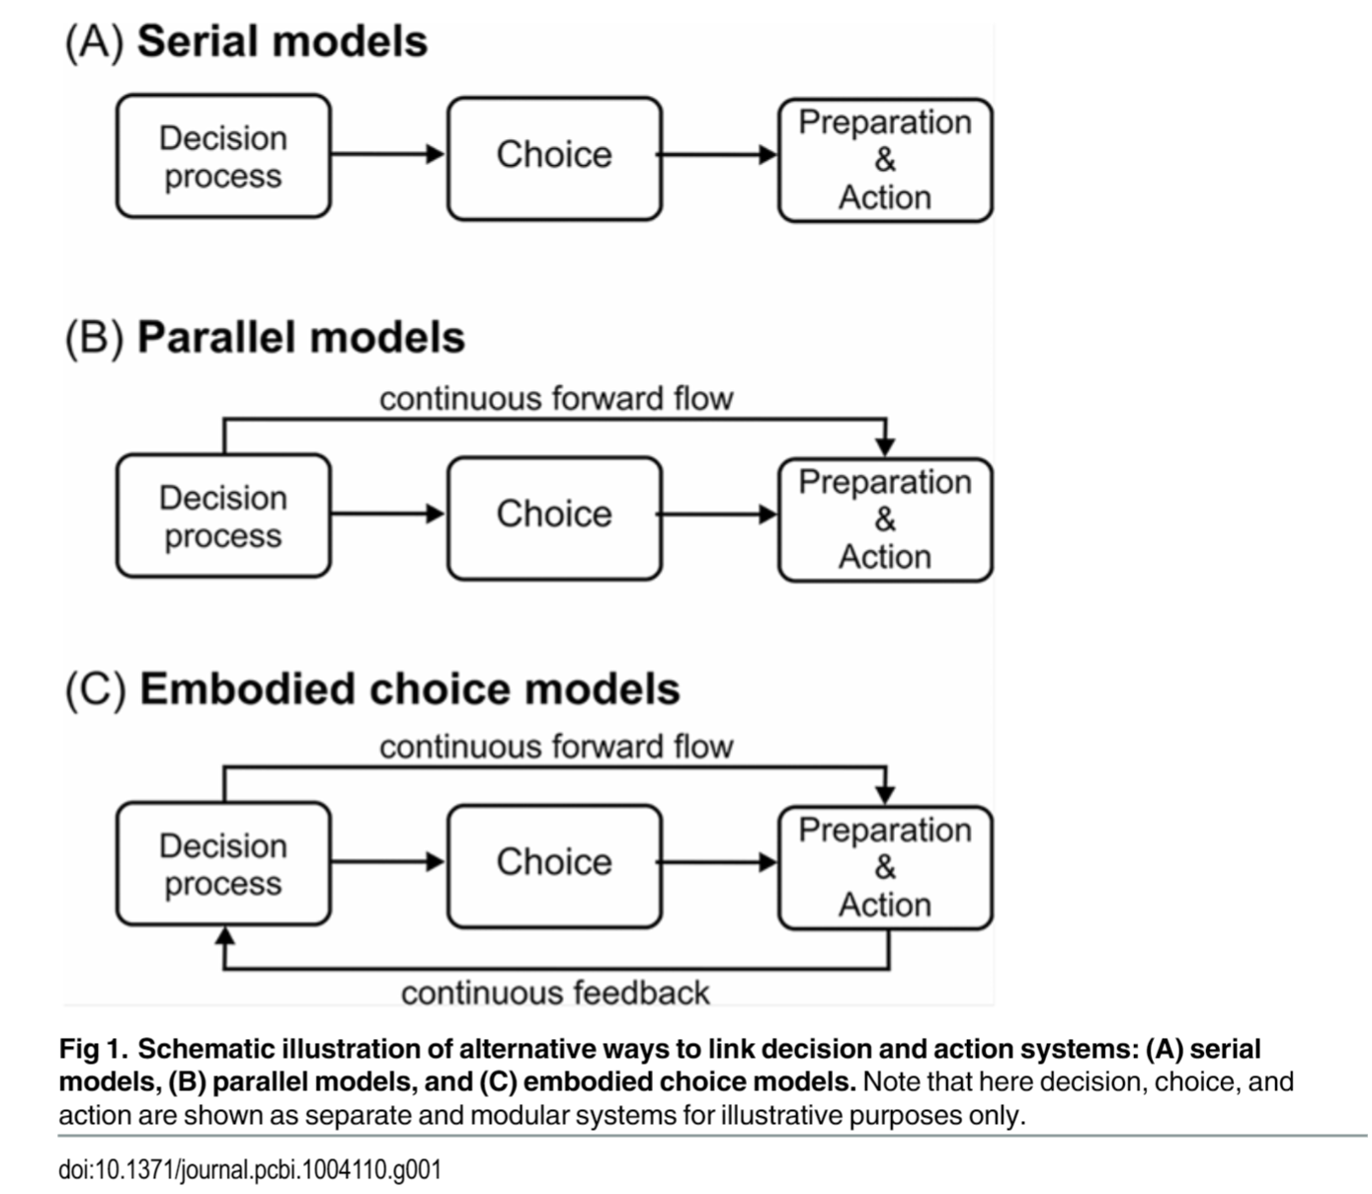
Decision making model type
Notes:
这是三种模型，实际上有四种，但是两个平行的合并了
串联模型是指先处理感官信息，然后做决定后开始执行motor response。
然而连续流模型认为一旦受到感官信息，就开始向motor传输信号用于plannging或excutation.意味着在决策结束前，运动系统已经对potential action准备好了。
第二个平行模型加了一个 response/action preparation (后面假设里会用到的概念)，它允许,提前启动动作,在累积的信息通过决策边界前。
目前最权威的EEG， NI model类似于第一种平行模型，最新的EMG， DTDM 类似于第二种平行模型（会在方法部分讨论这两个模型）
最后一种模型包括了一个连续的feedback loop，且加入了commitment effect。 意味着CoMs随着action的结束越难少可能发生。
这个学习比较了四种决策模型，一种decision-then-action,两种decision-and-action，一种action feedback into decision-making。发现后两种更好，且更能解释action如何影响decision
所以给我理由从不同肌肉反馈回路开始，利用motor延迟研究，motor preparation process。
%%%%%%%%%%%%%%%%%%%%%%%%%%%%%%%%%%%%%%%
In the series model, sensory information about the environment is processed, a decision is made based on this information, and finally, a motor response is executed. However, the continuous flow model suggests that as soon as sensory information is perceived, it begins to influence motor planning. This means that even before a decision is consciously made, the motor system is already preparing for potential actions.
总结
The study compares three models of decision-making: serial (decision-then-action), parallel (decision-and-action), and embodied choice (action feedback into decision-making). Key findings demonstrate that embodied choice models, incorporating action preparation and commitment mechanisms, better account for how actions influence decisions
A second parallel model (Model 3) includes an action preparation mechanism that permits action initiation before the accumulated information passes a decision bound. （如今的NI model）
commitment effect: changes of mind become less likely as the action nears completion 来自feedback loop
需要对不同位置肌肉的研究来研究反馈回路

Slide 10

Continues flow
Adaptive behaviour
Forward flow
Feedback flow
reflex gains adaptation
sensory attention biased
Implies dynamic decision thresholds/ urgency signal
Sensitive to new information
Notes:
连续流可以很好的解释adaptation，作为持续interplay between sensory inputs and motor outputs的结果。这很好的解释了人们不停的整合新的信息来实时调整他们的motor plan。
但是大部分分文章集中在forward flow。最流行的statement是: the motor system does not wait for a decision to be fully formed before beginning to prepare for action. Instead, it receives a continuous flow of information about the evolving decision。
Feedback flow （也有适应的行为被发现）：任务中perturbance手用震动，发现reflex gains可以实时调节sensory strength and durtion，类似乘除accumulated evidence/DV
证明了在sensory processing areas and motor planning regions ，存在feedback loop，这意味着motor planning不仅可以根据sensory input调整，还会受到the state of motor planning的影响
比如在正在准备的特定行为中（比如左或者右），感官注意力可能偏向于左的刺激。且预测更可能在FDI中观测到而不是BCP。
此外，目前的研究认为决策边界时动态受 level of motor preparation影响的。意味着 the readiness to action/response 可以影响 how the brain processes sensory information。
换句话说，motor planning可以使DM系统对新信息更敏感。
%%%%%%%%%%%%%%%%%%%%%%%%%%%%%%%%%%%%%%%%%%%%%%%%%%%%%%%%%%%%%%%
Continues flow supports the understanding of adaptive behavior as a result of the constant interplay between sensory inputs and motor outputs. It explains how individuals can adjust their actions in real-time based on changing environmental conditions, by continuously integrating new sensory information with ongoing motor plans. （大多数集中在forward flow）
Forward flow （包括运动准备信号）: the motor system does not wait for a decision to be fully formed before beginning to prepare for action. Instead, it receives a continuous flow of information about the evolving decision
Feedback flow （也有适应的行为被发现）: allowing reflex gains to modulate in response to the strength and duration of sensory evidence
reflex gains were measured by 随机扰动手臂, showing that they adapt based on the accumulated evidence leading up to the decision.
The model posits that there are feedback loops between sensory processing areas and motor planning regions in the brain. This allows for adjustments in motor preparation based on ongoing sensory input and even for sensory processing to be influenced by the state of motor planning. For example, if a certain action is being prepared, sensory attention may be biased towards information relevant to that action.
In sequential sampling models of decision-making, the concept of a continuous flow suggests that the decision threshold, which represents the amount of evidence required to make a decision, isn't fixed. Instead, it can be affected by the level of motor preparation. This means that the readiness to act can impact how the brain processes sensory information. In other words, ongoing motor planning can make the decision-making system more or less sensitive to new information.
传略的调整边界

Slide 11
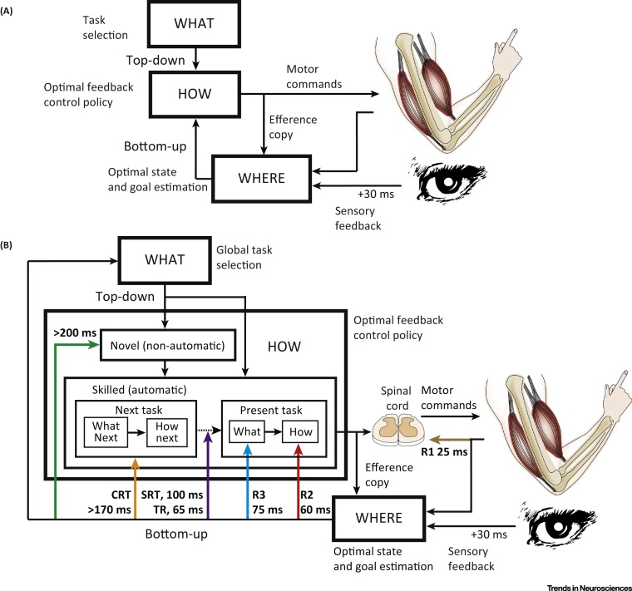
Top-down & Bottom-up flow timing
Biceps(15ms),FDI (25ms) .etc
less latency
similar amplitude/EEG wave
limb 60ms +;vision 90ms+ (C1);
distal muscle delay 10ms
Notes:
分开讨论forward flow 和feedback flow
存在不同回路上时间的区别
放置电极实验, 测试了很多肌肉，发现
不同肌肉的EEG latencies随着离脑的距离增加，如BCP15ms,FDI 25ms
但是EEG的amplitude 在不同肌肉间相同，意味着sensorimotor cortex 对于进远端肌肉没有明显区别
、
另一个review展示了三个核心进程的框架，behavioral goal是 (WHAT），身体present state是（Where）, motor commands 是（how）.
It emphasizes 了sensory feedback 的作用在more fluid, accurate, and effortless 的motor action. 在我的实验中力需要维持在一个threshold。（方法部分介绍 ）
简单来说我们需要更好地解释motor preparation,但是它会被feedback, sensory, top-down 同时影响。之前只研究了top-down。
结果表明对肢体传入的feedback反应至少60ms（一圈60，远端慢10ms。对视觉传入的要90ms, 65-90的不同对应了C1的时间？
%%%%%%%%%%%%%%%%%%%%%%%%%%%%%%%%%%%%%%%%%%%%%%%%%%%%%%%%%%%%%%%%%%%%%%%%%%%%%%%%%
The latencies and amplitudes of the cerebral potentials varied across muscles, with proximal muscles like the anterior deltoid showing shorter mean latencies (15.0 ms) compared to distal muscles like the first dorsal interosseous (25.0 ms).
The amplitude of brain potentials did not vary significantly between different muscles of the upper limb, suggesting that the sensorimotor cortex's representation does not differ markedly between proximal and distal muscles.
The review outlines a framework based on three core processes: defining the behavioral goal (WHAT), determining the present state of the world and the body within it (WHERE), and generating motor commands to achieve the goal (HOW). It emphasizes the role of sensory feedback in learning and modifying motor actions, making them more fluid, accurate, and effortless.
对肢体传入的feedback反应至少60ms（一圈60，远端慢10ms）

Slide 12
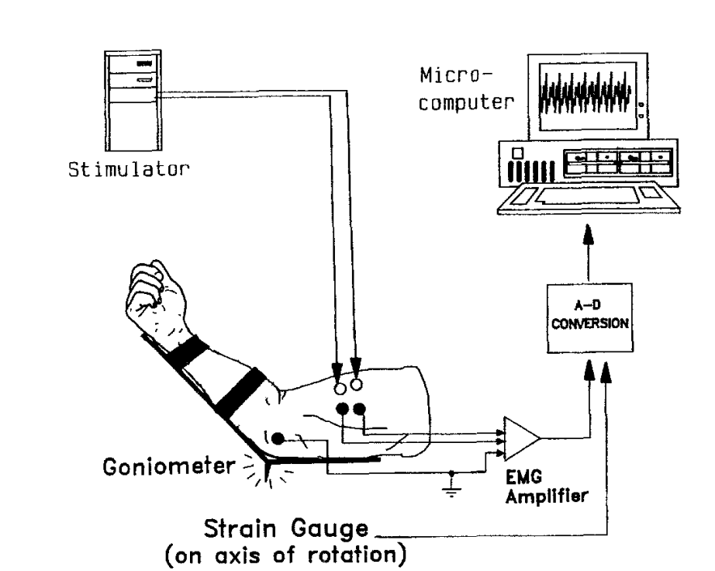
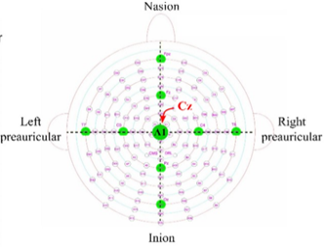
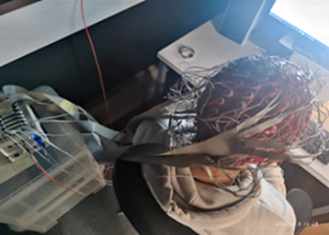
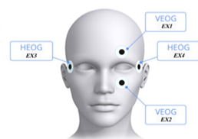
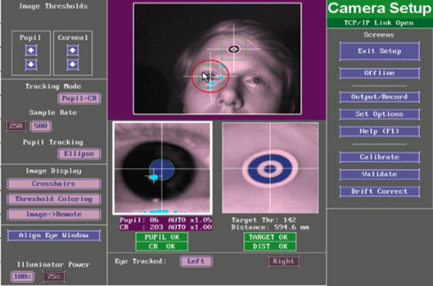
Experiment setup
Fig.4 EMG on biceps (left); EEG cap (right)
EEG – 512Hz 128 channel 10-20 layout Biosimi
EMG – 2000Hz 4 channel Delsys Trigno
isometric contractions
keep the angle of the elbow joint at 115°
Fig.5 External EOG channels location (left); Eye-link system interface(right)
Notes:
常规的EEG设置，这个阶段的实验不会用到Eye-link,但后续可能加上
不同的是EMG的设置，在FDI和biceps个放置左右两个感应器，让肌肉做isometric contraction,且手臂的夹角需保持115度

Slide 13
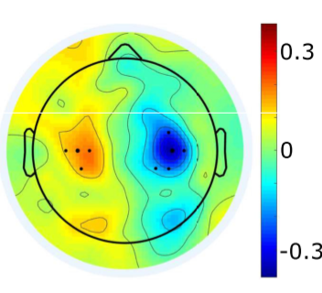
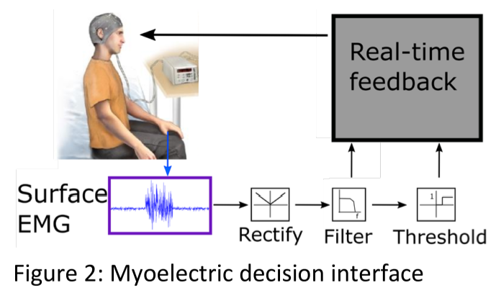
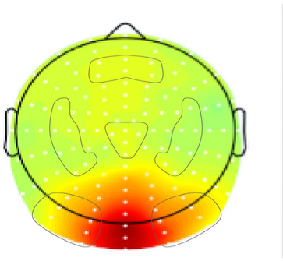
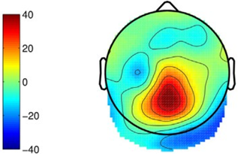
Experiment setup
Closed-loop muscle-computer interface
Stimuli design (3 key levels)
SSVEP at 21.5Hz
Smooth transfer to Evidence onset (clear CPP)
Motor preparation signals (14-30Hz)
Notes:
这是一个muscle computer的闭环控制界面，反馈由精确控制的肌肉激活提供（维持在某一水平50ms），关于决策形成的EEG特征同步记录
需要设计刺激能从EEG中追踪决策过程的演变 （三大level, sensory，cognitive， motor）
21.5hz的SSVEP可以反应evidence强度
Smooth transfer to the stimuli onset 可以使CPP更清晰，CPP是effector independence的，意味着两个肌肉相同
motor preparation signals 是effector-selective 的 有build-to-threshold activity 导致响应，可以比较不同效应器的不同
a closed-loop muscle computer interface for decision making in which a carefully controlled muscle activation triggers a response, while EEG signatures of decision formation are simultaneously measured.
The stimuli should be designed so that the evolution of the decision process can be traced in EEG measurements at 3 key levels in the brain.
1) The sensory evidence will be modulated at specific frequencies designed to produce a steady-state visual evoked potential (SSVEP) that represents the strength of
the sensory evidence encoding30.
2) Smooth transitions in the stimulus display will minimise visual evoked potentials due to sudden onsets, providing a clear view of the effectorindependent signature of evidence accumulation known as the centro-parietal positivity (CPP)40.
3) We will measure effector-selective motor preparation signals in the Beta band (14-30 Hz) which exhibit build-to-threshold activity leading up to a response

Slide 14
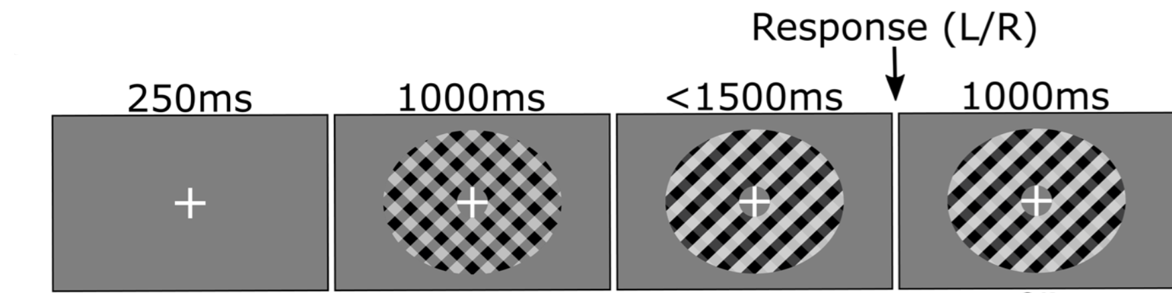
Polit Experiment design
2 Response effector – FDI and Biceps
2 contrast/coherence level – easy and hard
1 force level - 10% MVA (optional 20%)
2 speed pressure - accuracy or speed prior
96*5s trials *10 blocks =80 min
120 trials* 8 conditions
Notes:
contrast discrimination task 作为polit ；
下面是示意图，时间上有些改变，如800ms. 主要不同是反应阶段
特定阈值的肌肉激活作为反应，且将会提供施加力的实时反馈，频幕上显示进度条
参与者将会学习如何控制他们的FDI肌肉与BCP肌肉
两个难度two difficulty levels
1个力 (大力有维持的反应feedback loop，小力直接击穿) 需要测试出用大还是用小
速度准确率权衡

Slide 15
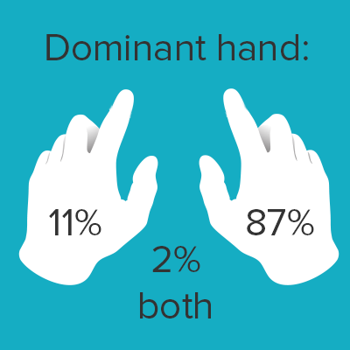
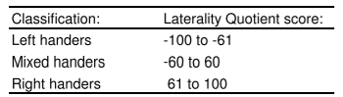
Edinburgh Handedness Inventory (EHI)
Notes:
为充分利用politi 引入主手问卷，因为发现很少研究研究左右手对决策适应的影响，左右bicep的力度差异很大，与脑部的链接可能有差异。同理左右手的灵活度。
生活中有部分半偏右的人，少量左撇子。有谁是左撇子或者部分右吗？

Slide 16
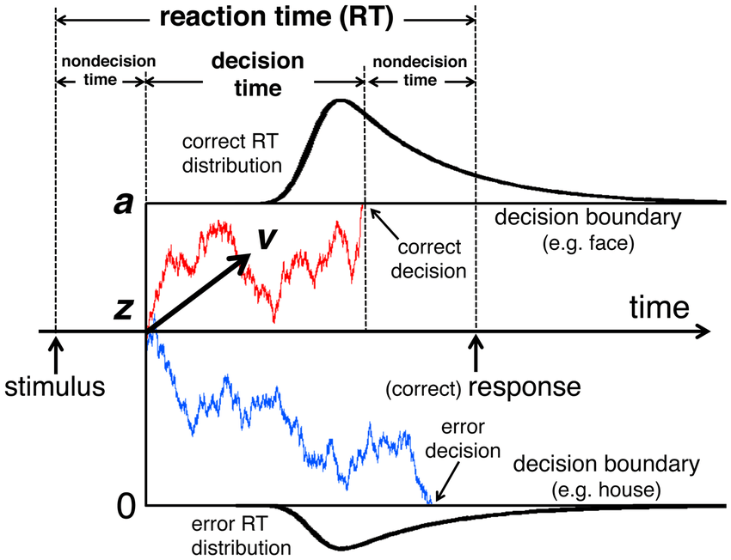
EEG model - NI
Shown decision adaptations to time constraints, stimulus strength, and prior probabilities
two- race to threshold motor preparation signals
Compare multiple processing levels
Notes:
NI 不仅解释行为数据好，还能解释neural process到决策好。
已经证明了adaption 在时间压力下，刺激强度和先验预期，
且发现了两个race to threshold 运动准备信号，只是按钮，先到达阈值的为决定
不同点DDM用感官信息表示平均drift rate;NI 加入了urgency signal,与证据无关even先于刺激
Prior probabilities 会影响initial stance toward one decision
Pre-evidence Motor Preparation信号 会prepares responses 先于必要信息 例如：Mu-beta (MB) decreases 382 ms post-cue for the deadline regime and 676 ms for the Easy and LoCoh regimes
分为三个部分evidence encoding, the onset of evidence accumulation, and the time after the decision for motor execution
在NI模型的帮助下,可以比较不同的阶段以及muscle activation
解释之前的信息，眼睛的延迟在sensory，motor的延迟，decision time 是否会同步下降
%%%%%%%%%%%%%%%%%%%%%%%%%%%%%%%%%%%%%%%%%%%%%
Source of Evidence Accumulation:
DDM (Drift Diffusion Model) assumes a single source of evidence accumulation, which is sensory evidence affecting the mean drift rate.
NI model introduces an additional urgency signal that isn't tied to sensory evidence. This signal influences the decision process even before sensory evidence is processed.
Temporal Components:
DDM has one non-decision time that covers all time not spent on evidence accumulation.
NI model breaks down temporal components into three parts: the onset of evidence encoding, the onset of evidence accumulation, and the time after the decision for motor execution
Decision bounds: speed accuracy trade of
Prior Probabilities:. Prior probabilities bias the initial stance toward one decision, affecting how quickly evidence accumulates towards a decision threshold
Urgency Signal: The urgency signal speeds up decision-making as time passes.
Pre-evidence Motor Preparation: The system anticipates possible outcomes and prepares responses even before all necessary information is available, as indicated by pre-evidence motor preparation signals. Mu-beta (MB) decreases 382 ms post-cue for the deadline regime and 676 ms for the Easy and LoCoh regimes

Slide 17
EEG pre-processing methods
Annotate data
Filter data :
(0.1- 30 + 50*n Hz notch filter)
Epoch
(Stimulus-locked / response-locked )
Bad channels detection & interpolate (SD>50)
Re-reference the data to CAR
Interpolate bad channels on a trial-by-trial by TBT
Mark trials with eyeblinks & artefacts during pulses for rejection (AI)
CSD filtering
Time-frequency analysis
Fieldtrip
Beta power analysis: Morlet wavelet
DV calculation and
Fit Normative model
Group-average plotting
Notes:
常规EEG预处理正在使用的流程图
如果可以用emg的时间作为RT,或许更准确
e.g check the portion of pre motor time and motor time
AI的方法扔掉太多，网站肉眼方法太慢

Slide 18
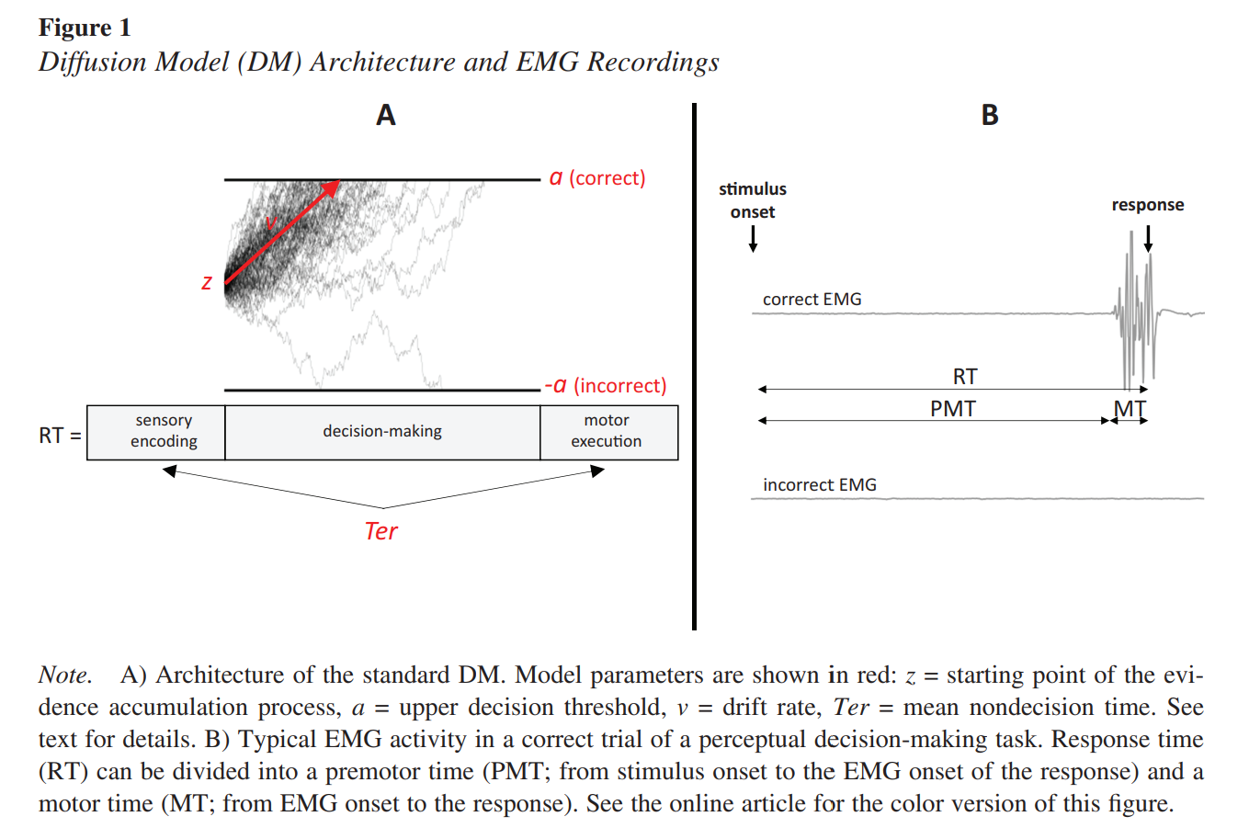
EMG model- DTDM
nondecision time 300-400ms
sensory delays (220ms)
motor delays (80ms)
Notes:
为了研究motor execution，EMG模型也有四个组成部分.
EMG的RT由PMT 和MT
PMT premotor time= sensory accumulation + decision making
MT motor execution time 和传统DM一样
可以更精准的定位decision commitment
另一篇文章读到300-400ms的非决策时间，其中220来自感官，80来自motor

Slide 19
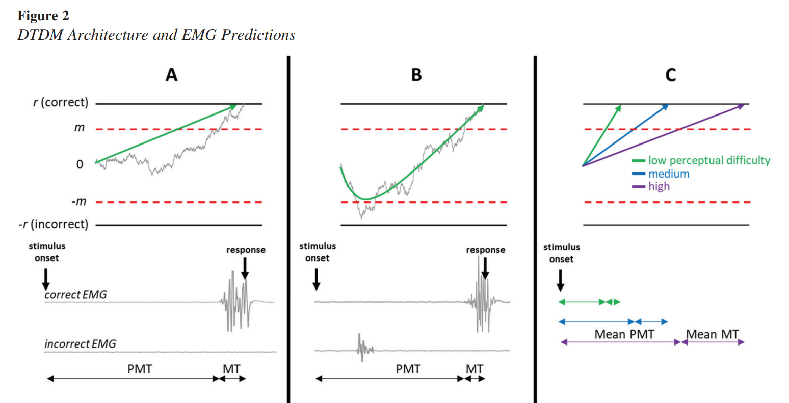
EMG model- DTDM
When coherence ⬇
PMT & MT monotonically ⬇
Drift rate ⬇
Partial bursts number ⬆
First partial burst time ⬆
* Similar to CoMs
Notes:
提出了Double threshold diffusion model,有一个类似于CoM的边界m，到达会有parial burst. (图b)也会有第二个边界类似commiment，到达没有回头路
他们用的是Random dot motion task
当coherence 下降
1.PMT和MT 同步减少（图c）
2. 漂移率与DDM模型一样来源证据强度
3. Partial burst次数变多，因为更容易改变想法
4.第一次出现的Partial burst变晚，因为需要积累跟多时间
与CoMs有关，信息仍在被处理，并且可以推翻初始决策
%%%%%%%%%%%%%%%%%%%%%%%%%%%%%%%%%%%%%%%%%%%%%%%%%%%%%%%%%%%%%%%%%%%%%%%%%%%%%%%%
Mean PMT and mean MT should monotonically increase as motion coherence decreases.
drift rate, and should thus monotonically decrease as coherence decreases
The proportion of trials featuring partial EMG bursts should increase as motion coherence decreases,
The latency of the first partial EMG burst should increase as motion coherence decreases
Similar to Change of mind ---information still in the processing pipeline at the time the initial decision is made to either reverse the initial decision
nondecision time 300-400ms
220 ms for sensory delays and 80 ms for motor delays

Slide 20
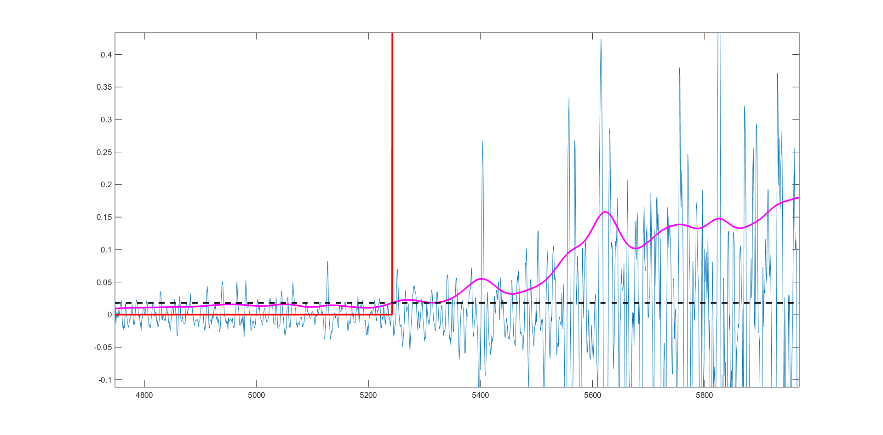
EMG analysis methods: linear envelope (ENV)
Pre-processing and artifact rejection (notch + band-pass filtering between 20 – 450 Hz)
Modulus
Low pass filter (usually with a cut-off < 20 Hz)
Set a threshold at mean + 3 sigma of the noise level
Figure 2: Three contractions on each channel of the EMG signal; The red line represents the region where the muscle contraction is ‘on’
But not sensitive to capture small signal + noise. (which is important in DTDM model!)
Starting time not accurate
Notes:
也搜了EMG分析方法，主要成分在20-450
粉红色是处理后的
取rest期 的3sigma来绘制envelope
89.7%的噪声被过滤，留下噪声+信号
但是第一个问题是对小信号不敏感（深蓝色图）
第二个是起始时间不准确（深蓝色图）
%%%%%%%%%%%%%%%%%%%%%%%%%%
9.7% of noise sample will fall in this interval, any sample above will probably NOT be noise, but signal + noise
Tkeo 新EMG方法

Slide 21
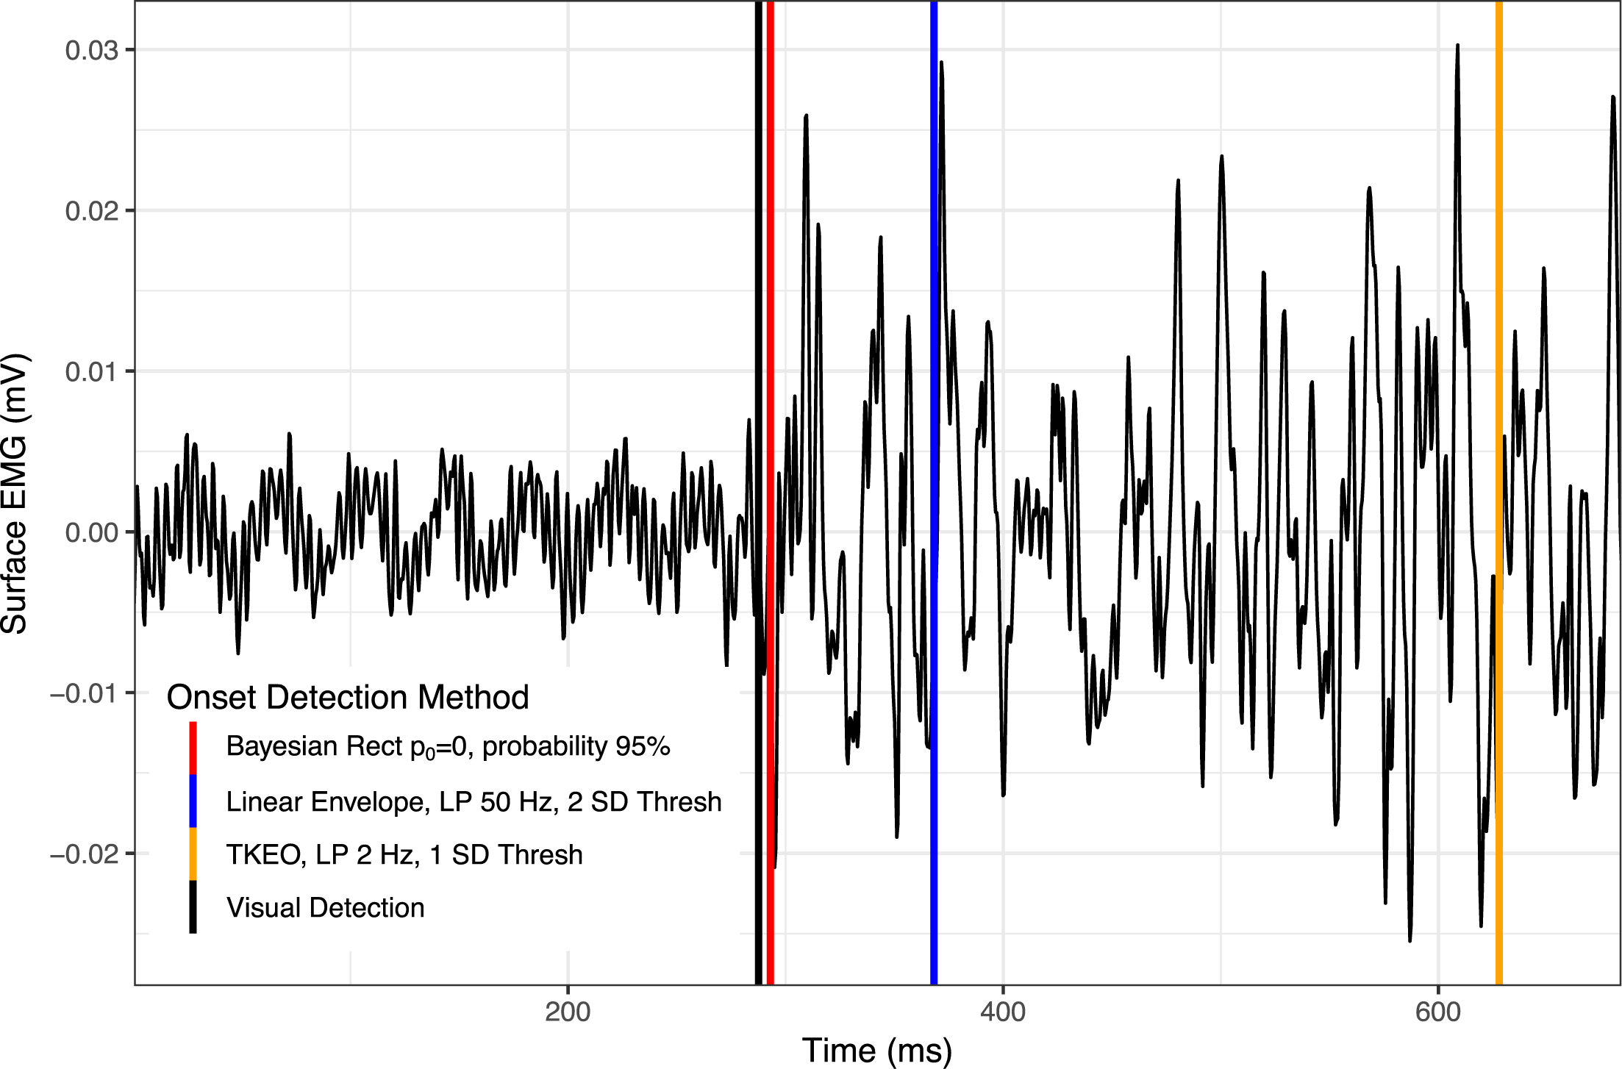
EMG analysis methods: Teager-Kaiser Energy Operator (TKEO)
energy -> instantaneous amplitude and frequency
depolarization of the muscle cell membrane during contraction
The Sample Entropy (SampEn) algorithm has also been shown to have accuracy similar to TKEO while being more robust to artifact
Notes:
EMG的主要问题是SNR
TKEO方法提高了边界的精度（看图对比）
, 通过瞬时amplitude和功率计算energy
原理是收缩时肌肉细胞膜的去极化引起快速的amplitude和功率的波动
虽然解决了SNR,但是对皮肤伪影很敏感，在FDI的条件下（用力维持时）， 用熵的方法更合适
%%%%%%%%%%%%%%%%%%%%%%%%%%%%%%%%%%%%%%%%%%%%%%%%%%%%
increases the detection accuracy of EMG burst boundaries.
calculated energy is derived from instantaneous amplitude and instantaneous frequency of the signal
depolarization of the muscle cell membrane during contraction produces rapid fluctuations in signal’s amplitude and frequency

Slide 22
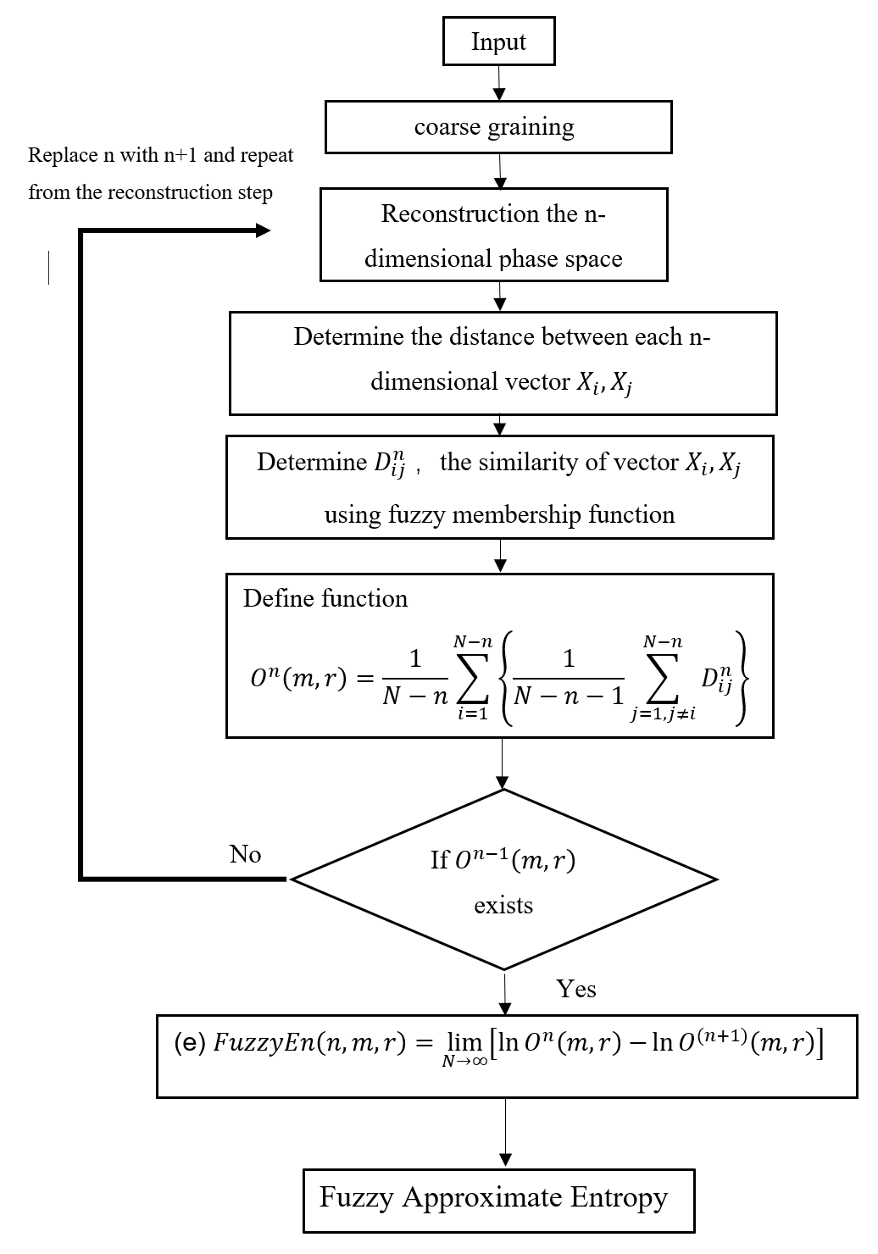
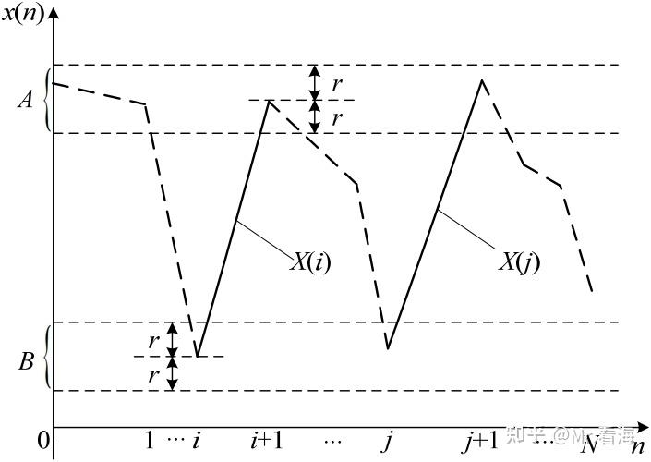
EMG analysis methods: non-linear
Fuzzy entropy (EMG/EEG) : feature extraction and classification
a new measure of time series
robustness to noise
converge for small sample size
good for short trial
Sliding short window (200-5000 data point) to sensitively find partial burst burst
Notes:
https://www.sciencedirect.com/science/article/pii/S1050641112001150
这是比sample 熵升级一次的，2007年的算法。近似熵是随古老的没优化版本
原理是评价波形前后混乱程度，（模式的重复性）
先粗粒化后选择维度，二维的例子，r代表近似的值，区间内认为相同。
Sample用了自身比较，Fuzzy加入了一个0.8yes 0.2 no。
在适合SNR的同时，可以适用于很小的数据集，和最少200个数据点，很短的trial。且对atifacts有抗性
滑动窗口可以很灵敏的检测出parial burst
%%%%%%%%%%%%%%%%%%%%%%%%
从原理上能看出来，这三个数据都是评价波形前后部分之间的混乱程度的。所以这三个数据都是评价波形前后重复性的，也就是频率。熵越大，波形中各个频率越多，熵越小，波形中乱七八糟的频率越小。
三个之间的区别的话
近似熵，1991年的算法。
样本熵，2000年的算法。近似熵在比较的时候有一个自身比较的数值在里面，这个算法优化了。
模糊熵，2007年的算法。前面两个算法在评价时加入了一个阈值：大于阈值就混乱，小于就不混乱。模糊熵加入了一个fuzzy的思想在里面。更科学一些。
啥叫fuzzy，就比如说，原来分男女，只有 是 或者 不是 这种。现在加入了模糊思想，就告诉你，这货有0.8的概率是男的，有0.2的概率是女的这种。这种软分类其实更科学的。更多的可以参考fuzzy c means算法。
a new measure of time series
robustness to noise
converge for small sample size
good for short trial (<5s)

Slide 23
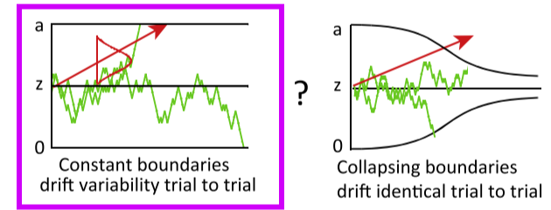
Hypothesis
No partial EMG burst in biceps(change of minds)
Partial EMG burst in biceps (response preparation)
More medial areas of the motor cortex for biceps
Non - decision time decrease
Decision time decrease partially
EEG --> sensory evidence; EMG --> behaviour results (Proximal accuracy< Distal accuracy)
Different dynamic decision thresholds shape
Notes:
1, 从物理不同推断biceps 更偏向serieal. 可以用CoM解释
2. 与motor preparation不同，EMG层面的。需要prior property有关的实验 （分离motor 和decision）
3. 右减左更靠近中间
4. Becips的非决策时间更短, 1.top-down(连续流)和反馈回路更快，2.且于脑连接更少，3.feedback弱，控制由预先编程
5.检查是否决策时间同比例减少，FDI在sensory-motor area有额外链接，有时motor也可通过feedback影响decision
6.信息流，EEG的signiture更能反映感官证据，EMG应该与行为数据更反应。信息一边被加工一边被传递SSVEP>CPP>motor>EMG。远端肌肉由于延迟信息被处理了更长时间，预测近端远端的正确率会有区别。
7.预计观察到不同的边界或者urgency signal
边界positive effect， 滚雪球；自我加大，
4. Less motor execution time for biceps 更快top-down loop and less feedback
5. decision time decrease partially (more simply connection, less sensorimotor integration/feedback loop )
6.for continuous flow, EEG should more related to sensory evidence, and EMG should more related to behaviour results
Distal more complex, more decision process /information processed during the flow
7. From continues flow, boundary may different
边界positive effect， 滚雪球；自我加大，
Read urggency+ Cisek 的paper urgency gating model adding to acc+grows over time+***evency +Leak signal
和 bound一样。 Later is more important
cortious
动态的可以突然加减
不可以取消
Read triger
心理学内核

Slide 24
Expected result
Same CPP
Same speed-accuracy trade-off
Similar motor preparation signal
More precise decision commitment time
*Dominant hand difference
Notes:
希望结果
1.CPP一样
2. 速度正确率一样
3.Motor preparation小区别，如更靠近中心
4.更精确的决策承诺时间
Side mission是调查主手，因为becip力量差异大，FDI精确程度差异大

Slide 25
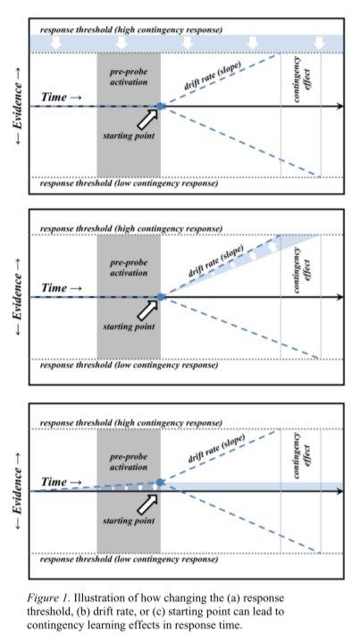
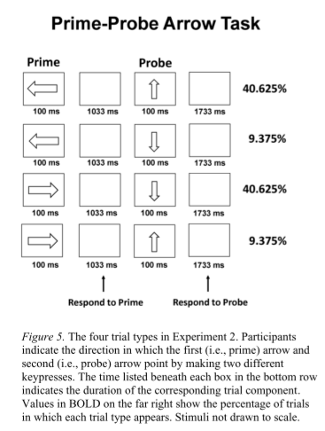
Possible experiment to explore response preparation and RT?
Force-sensitive keyboards & different force levels by EMG
Response preparation based on prior stimuli
Notes:
有两个刺激模式不同概率，然后按键
主要注意motor preperttion，response preparation 有区别
模型中改变很多东西可以改变RT
读这个的原因是 Emg界面可以一定程度上代替力敏感keyboard
即使在第二个刺激前力也会增加，根据概率准备动作
The study investigates contingency learning in decision-making through a prime-probe task with force-sensitive keyboards. It differentiates between response preparation and threshold-only accounts of learning, revealing that participants anticipate the likely response before stimulus onset, shown by increased force on the key corresponding to the expected direction.
individuals not only adjust their response thresholds based on prior stimuli but also prepare for likely outcomes by applying greater force on keys associated with expected responses, even before stimuli appear.

Slide 26
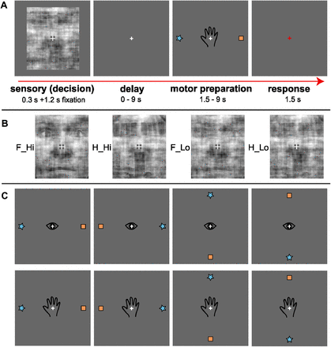
Possible experiment that separate perceptual DM and motor?
face- house detection then delay
sensorimotor areas do not accumulate sensory evidence
IFS for perceptual decisions (accumulate sensory evidence )
LIP for motor decision
Notes:
将知觉决策与运动规划分离，辨别是人脸还是屋子
直到刺激和延迟期之后，受试者才知道他们的反应是用眼睛运动还是手运动来执行的
是否还有motor preparation signal 在文章中读到Mu-beta (MB) 在时间紧条件下， 证据后382 ms下降 and 676 ms 对于简单和第coherence情况
证明了sensoriory-motor区不积累证据。IFS用作perceptual decisions, LIP 用作 motor decision。
分离了决策链，所以LIP更近似于behaviour result 而不是sensory input
因为
IFS showed greater activation for low- than high-evidence decisions. LIP showed a High-Low patten
%%%%%%%%%%%%%%%%%%%%%%%%%%%%%%%%%%%%%%
The findings reveal that sensorimotor areas do not accumulate sensory evidence towards a perceptual decision. Instead, areas like the inferior frontal cortex play a significant role in this process, particularly during the perceptual decision stage, but not during motor preparation.
IFS for perceptual decisions, LIP for motor decision, 在决策链的下端，所以更近似于behaviour result 而不是sensory input
left IFS integrates sensory evidence during perceptual decisions, while putative LIP participates in motor, but not perceptual, decisions.
IFS showed greater activation for low- than high-evidence decisions. LIP showed a High-Low pattern (?more sensory end than more behavior end?)

Slide 27
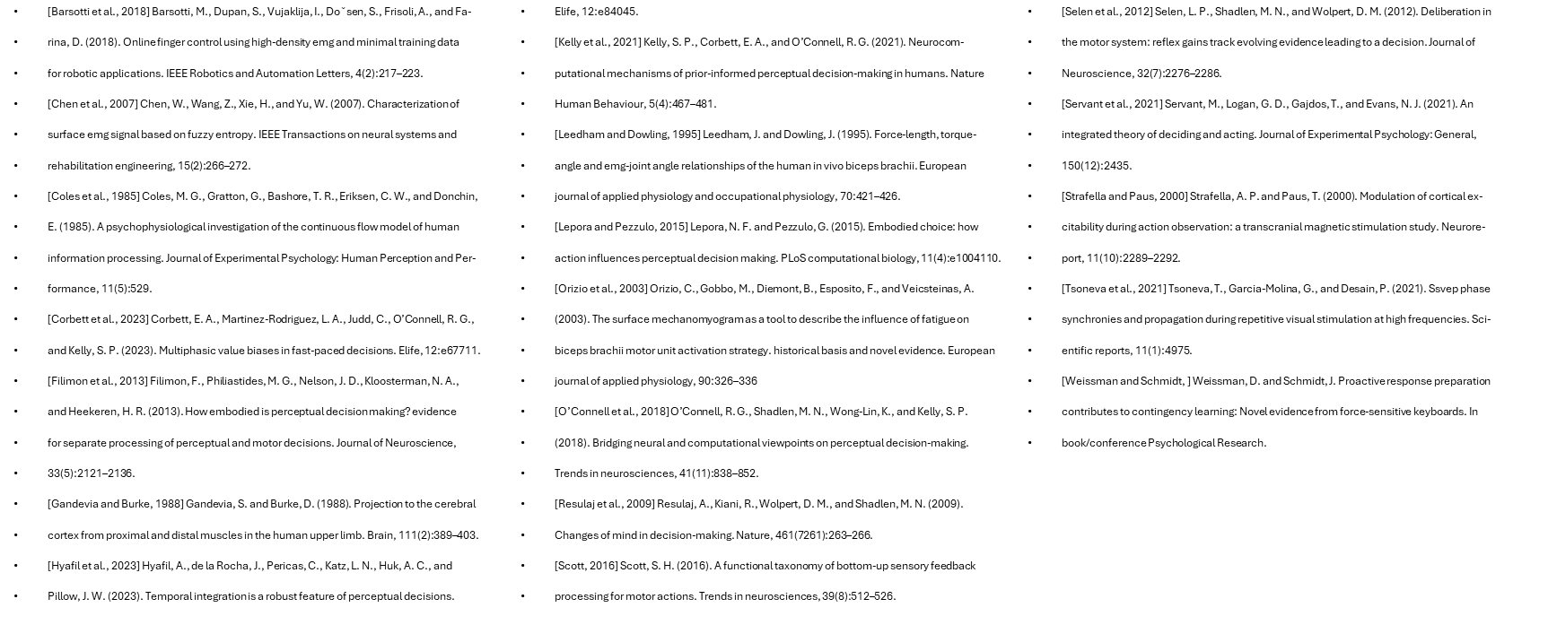

Reference
Notes:
Thanks for listening

